Slide 1

Open API Specification Continued
Learn Swagger and the Open API Specification
Security, errors, content types, and operation IDs

Slide 2
Introduction
Covers
Security
Error Conditions
Content types (JSON, JPEG, etc.)
Operation IDs

Slide 3
Security
Security means what kind of authentication or authorization is required
Authentication: the user has correct username and password
Authorization: the user has access to this API and data

Slide 4
Security types
None
Used for getting publically available information
API key
Indicates that the app has permission to use the API
Basic Authentication
Username and password is included in a header
OAuth
Complex issuance of temporary token

Slide 5
How security is indicated
Each operation has a security key
Contains an array of security definition objects
Often just one element in the array
Security Definitions
The file contains a securityDefinitions key
Typically at the end
Contains security objects
Security object
Contains information needed for that type of security

Slide 6
None
When you do not have security…
…you don’t need to do anything!
😀

Slide 7
API key
Add security key to each operation
Use dash to indicate an array
Create name for definition and use empty bracket, since no data is needed
Add security definition
Add definition for that name in securityDefinition section
type: apiKey
name: name of the header or query parameter to be used
in: query or header

Slide 8

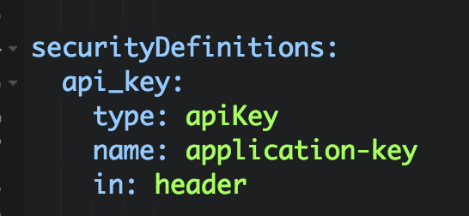
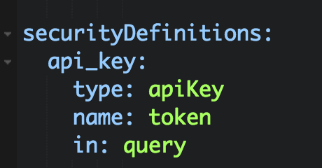
API key example
Put a security key in the get section and securityDefinitions at the end of the file
https://…?token=23a645ga2798

Slide 9
Basic authentication
Add security key to an operation
Use dash to indicate an array
Create name for definition and use empty bracket, since no data is needed
Add security definition
Add definition for that name in securityDefinition section
type: basic

Slide 10
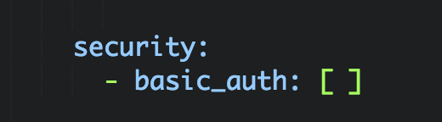
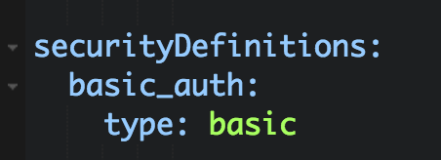
Basic auth example
Put a security key in the get section and securityDefinitions at the end of the file

Slide 11
OAuth
OAuth is too complicated to explain here
Add security key to request, like before
However, now you add scopes in the array
Add security definition
Add definition for that name in securityDefinition section
type: oauth2
authorizationUrl: URL where credentials are entered
tokenUrl: URL for the token
flow: OAuth 2 flow (implicit, password, application or accessCode.)
scopes: list of scopes with descriptions

Slide 12
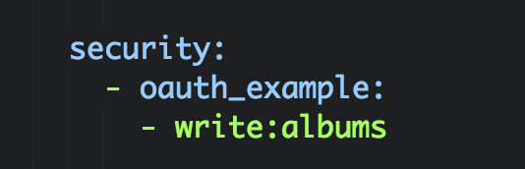
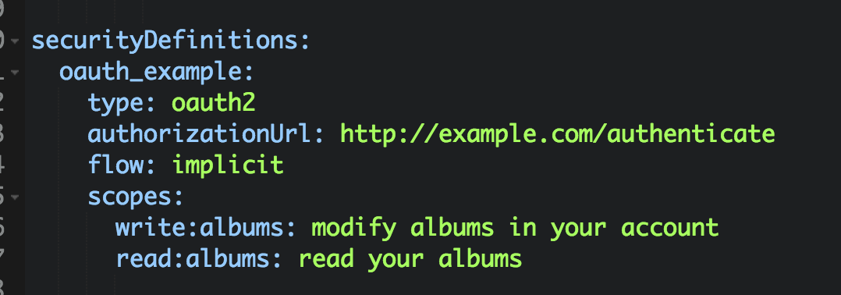
OAuth example
Put a security key in the get section and securityDefinitions at the end of the file

Slide 13
Errors
Errors are simply different response codes
Often APIs return a special structure with errors
Example 401 (Unauthorized) code returned
{"errorCode": 13, "message": "Username not found"}
Should include schema for every potential status code
Refer to this in response

Slide 14
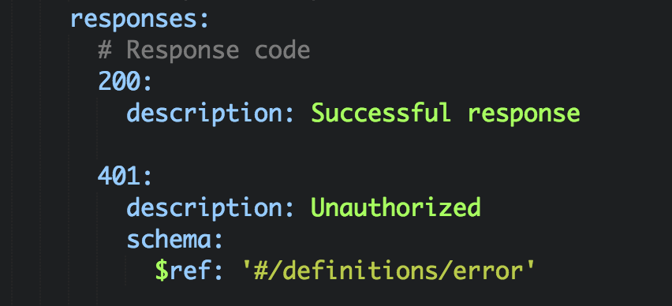
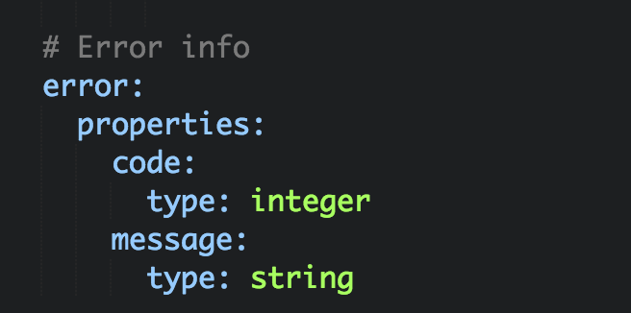
Error example

Slide 15
Content Types
Content types indicate the format of the data in the request and response bodies
This is done through the Content-Type header
You can specify this for:
The whole API
Individual operations
Use the consumes and produces keys
consumes for requests, produces for responses
Use the Content-Type value (for example, application/json)

Slide 16
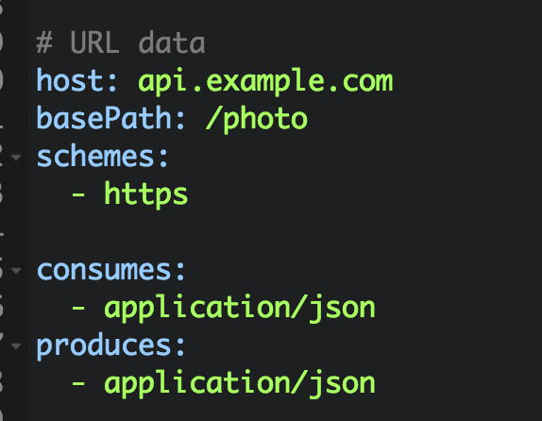
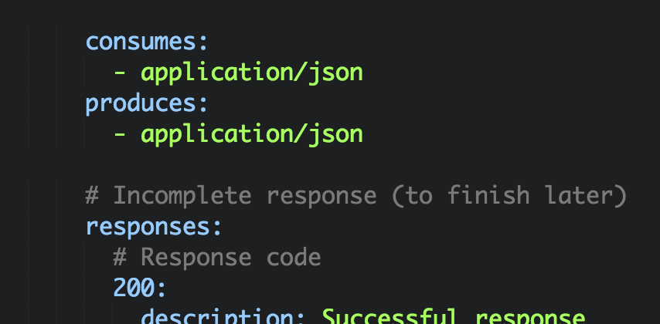
Example Content-Type

Slide 17
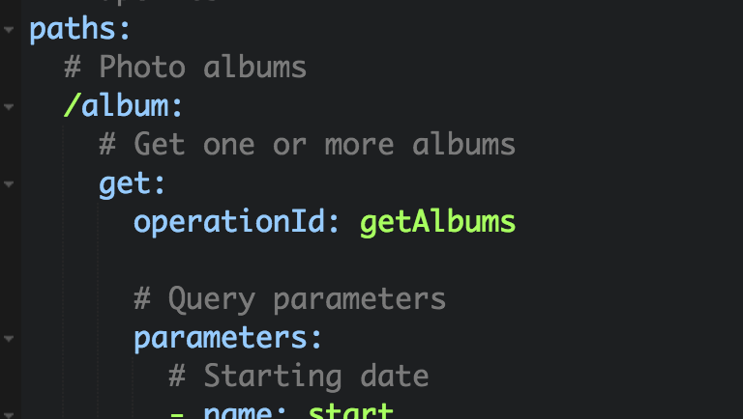
Operation ID
Although it doesn’t show up in the documentation, you can optionally add an operation ID to each request
Some tools will use this

